Slide 1

CAPSTONE PROJECT PRESENTATION
PREDICTING HOSPITAL READMISSION IN ACUTE DECOMPENSATED HEART FAILURE PATIENTS USING MACHINE LEARNING
Student: Shania K T Ruwende (R223747S) Supervisor: Dr. Kwangwa programme : Data science and Informatics (HDS) University of Zimbabwe

Slide 2


Presentation Roadmap
Part 1: Foundation
Part 2: Execution
•
Introduction & Challenges
•
Literature & Gaps
•
Problem Statement
•
Functionality (UML)
•
Research Questions
•
Methodology Pipeline
•
Objectives
•
Progress & Conclusion

Slide 3




Introduction and Challenges
Background
The Problem
Key Challenges
Acute Decompensated Heart Failure (ADHF) is a critical condition driving hospital readmission rates above 20% within 30 days.
Current tools like the LACE index are generic. They fail to capture the acute, episode-specific nuances of heart failure.
•
High Dimensionality: Complex medical data.
•
Class Imbalance: Readmissions are "rare events".
•
Black Box Models: Lack of clinical trust.

Slide 4
Research Questions
RQ1: Which machine learning algorithms yield the highest predictive accuracy for ADHF readmission?
RQ2: What specific clinical features are most significant for predicting ADHF readmission risk?
RQ3: How can Explainable AI be implemented to interpret model decisions for clinicians?
RQ4: To what extent does the proposed model outperform existing scoring systems like LACE?

Slide 5




Research Objectives
1. Train a Model
2. Determine Predictors
Develop algorithms (XGBoost, Random Forest) specifically on ADHF datasets to predict 30-day readmission.
Identify critical clinical features (for example BNP levels, congestion) driving risk.
3. Implement XAI
4. Evaluate
Integrate SHAP values to make the model transparent and trustworthy for clinicians.
Benchmark against traditional scores using AUC-ROC metrics.

Slide 6




Literature review and Gaps
AUTHOR | TITLE | KEY FINDINGS | GAP IDENTIFIED
Sabouri et al. (2023) | Machine learning based readmission... in heart failure patients. Sci. Rep | Machine Learning methods out performs statistics. | Lacks ADHF Acute focus
Zhao et al. (2020) | A Novel Mixed Sampling Algorithm for Imbalanced Data Based on XGBoost. Wireless Sensor Networks. | SMOTE can be used for rare events | Not tested on clinical data
Mpofu et al. (2024) | Predicting Model for Hospital Readmission of Diabetic Patients. IEOM Society International. | Machine learning is feasible in zimbabwe | It focuses on Diabetes not heart failure
Salih et al. (2025) | A Perspective on Explainable Artificial Intelligence Methods: SHAP and LIME. Adv. Intell. Syst. | SHAP is essential | Lack of Functional prototypes
SPECIFICITY
TECHNIQUE
TRUST
Sabouri et al. (2023)
Zhao et al. (2020)
Salih et al. (202)
M outperforms stats.
SMOTE for rare events.
SHAP is essential.
GAP: Lacks ADHF acute focus.
GAP: Not tested on clinical ADHF data.
GAP: Lack of functional prototypes.
LOCAL
SOCIAL
Mpofu et al. (2024)
Chopera et al. (2021)
ML feasible in Zimbabwe.
Psychosocial drivers.
GAP: Diabetes focus, not Heart Failure.
GAP: Not quantified in ML models.

Slide 7
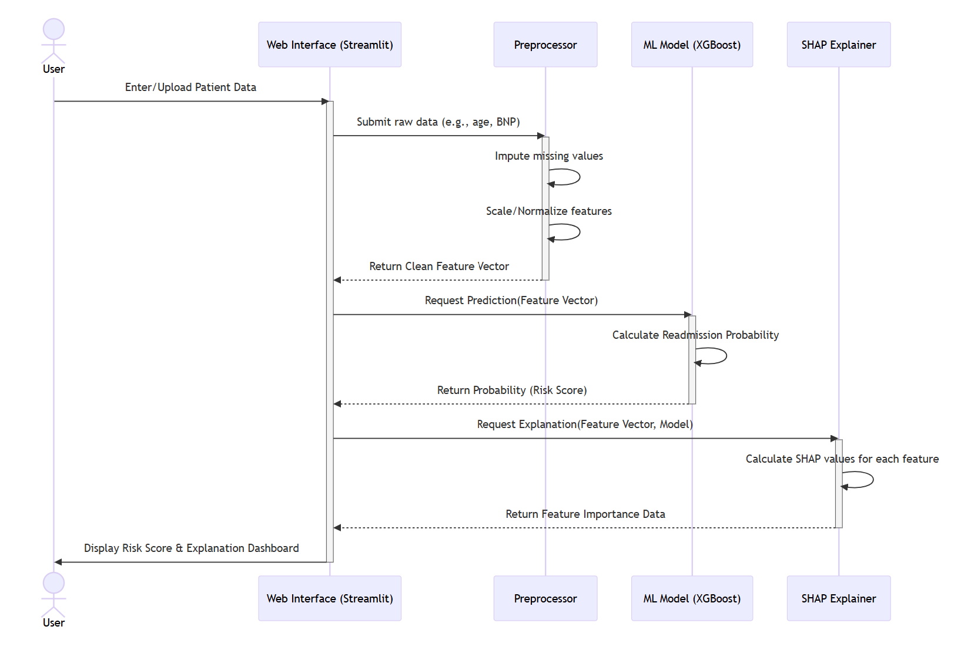
System Design: sequence Diagram
Illustrating the interactions between the Clinical User and the System

Slide 8








Methodology Pipeline
Data Source
Preprocessing
Training
Evaluation
UCI ML Repository and MIMIC-III. Filtered for heart failure ICD codes.
Cleaning, Mean Imputation and SMOTE to address class imbalance.
implementing XGBoost and Random Forest classifiers with Cross-Validation.
Testing via AUC-ROC, Recall, and generating SHAP explanations.

Slide 9

Progress Made
Literature Review Completed review of 30+ papers (Sabouri, Salih, etc.).
Gap Identification Identified lack of explainable, ADHF-specific local models.
Data Selection Selected UCI and MIMIC-III datasets; defined filtering logic.
Algorithm Selection Chose XGBoost for accuracy vs. Logistic Regression baseline.
System Design Created UML Use Case, DFDs, and Survey Paper.
Survey Paper Drafted comprehensive survey on ADHF prediction.

Slide 10


Conclusion
This research bridges Advanced Data Science with Practical Healthcare. By addressing specificity (ADHF) and transparency (XAI), the project aims to deliver a trustworthy tool for clinicians.
Questions?
Shania K T Ruwende (R223747S)

Slide 11
Key References
•
Mpofu, L. et al. (2024). Predicting Model for Hospital Readmission of Diabetic Patients. IEOM Society International.
•
Salih, A. M. et al. (2025). A Perspective on Explainable Artificial Intelligence Methods: SHAP and LIME. Adv. Intell. Syst.
•
Zhao, S.-X. et al. (2020). A Novel Mixed Sampling Algorithm for Imbalanced Data Based on XGBoost. Wireless Sensor Networks.
•
Chopera, P. et al. (2021). Relationships of depression and anxiety to readmission rates... Afr. Health Sci.
•
Sabouri, M. et al. (2023). Machine learning based readmission... in heart failure patients. Sci. Rep.

